Slide 1

Hertumig
VaudBiotech

Slide 2
Design notes
Delete
Use common web font: Arial
Work in ppt – finished backup on googleslides accessible by URL
Max 20 main slides
Minimise word count
Include citation in consistent format
VaudBiotech

Slide 3
Contents
Treatment
History
Guidelines and regulation
Pre-clinical plan
Clinical plan
Manufacturing
Scientific advice
Inspections
Overall strategy
Take home message
VaudBiotech

Slide 4
Treatment
HER2 positive breast cancer.
Caused by ERBB2 gene amplification
that results in overexpression of HER2.
Approximately 15-30% of
breast cancer tumors.
VaudBiotech

Slide 5
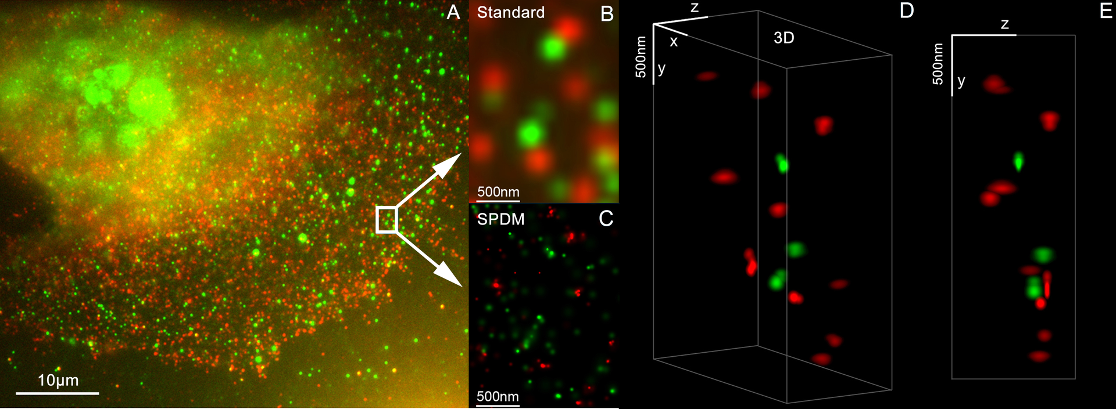
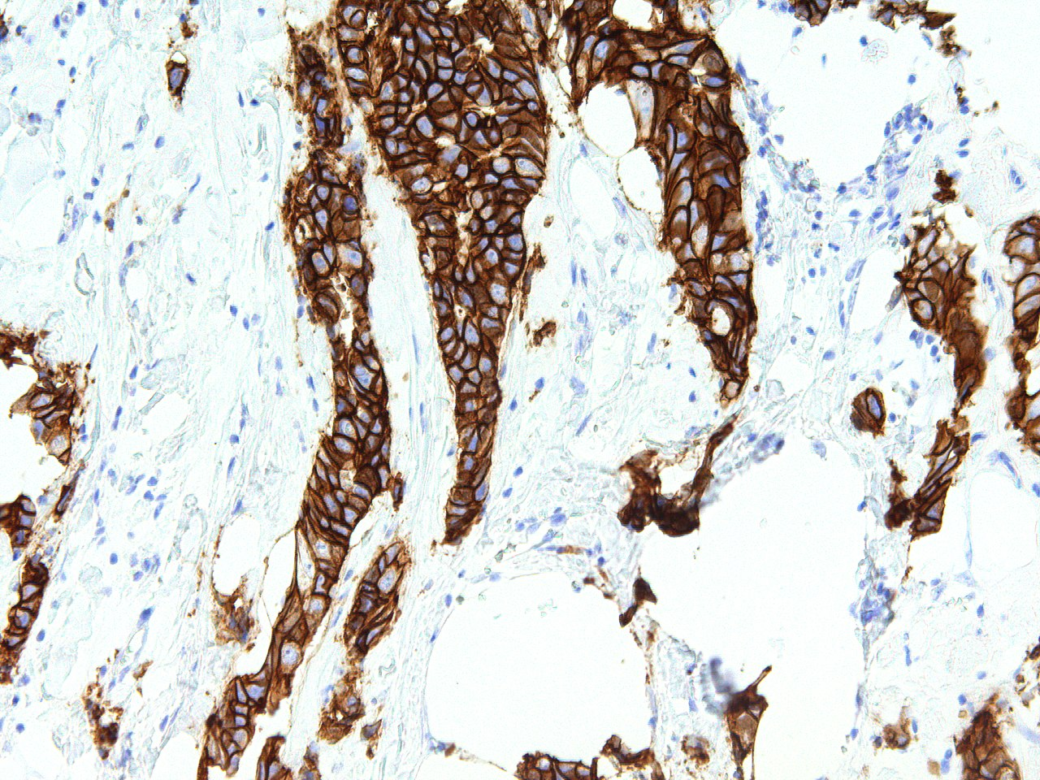
Treatment
Figure 1. Her2 and Her3 distribution on a breast cell, (3D Dual Colour Super Resolution Microscopy SPDMphymod / LIMON, marked with Alexa 488 and 568). Andy Nestl CC BY-SA 3.0.
Figure 2. Her2 staining on patient breast cancer tissue identified as stage 3. GenomeMe Lab Inc. http://www.genomeme.ca/molecular-pathology/Her2-Neu.html CC BY 4.0
VaudBiotech

Slide 6
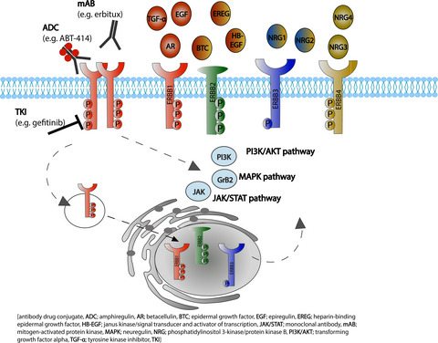
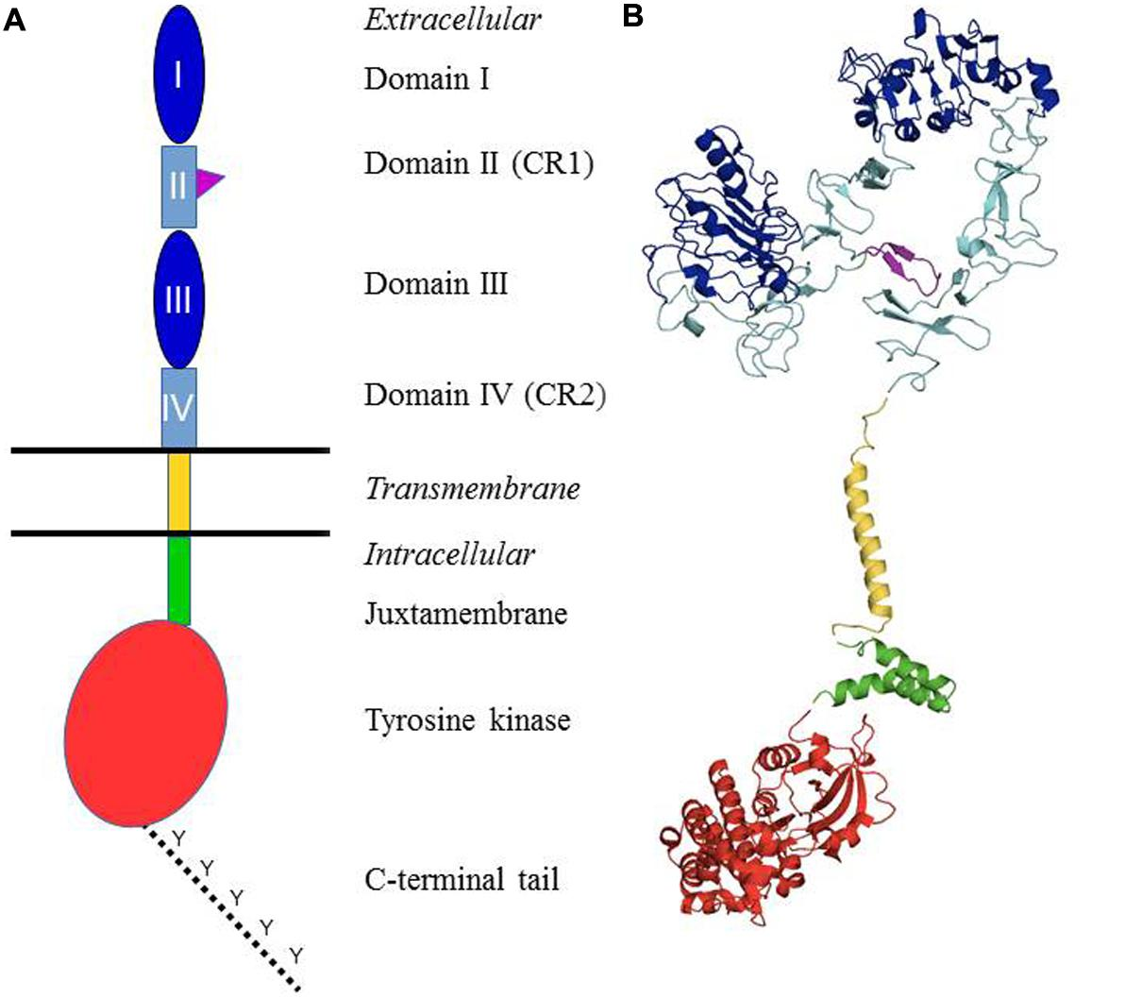
Treatment
Figure 1. von Achenbach, C., Weller, M. and Szabo, E. (2018), Epidermal growth factor receptor and ligand family expression and activity in glioblastoma. J. Neurochem., 147: 99-109. https://doi.org/10.1111/jnc.14538
Figure 2. Appert-Collin, et. al. Role of ErbB Receptors in Cancer Cell Migration and Invasion. Front. Pharmacol., 24 November 2015 Sec. Pharmacology of Anti-Cancer Drugs https://doi.org/10.3389/fphar.2015.00283
VaudBiotech

Slide 7
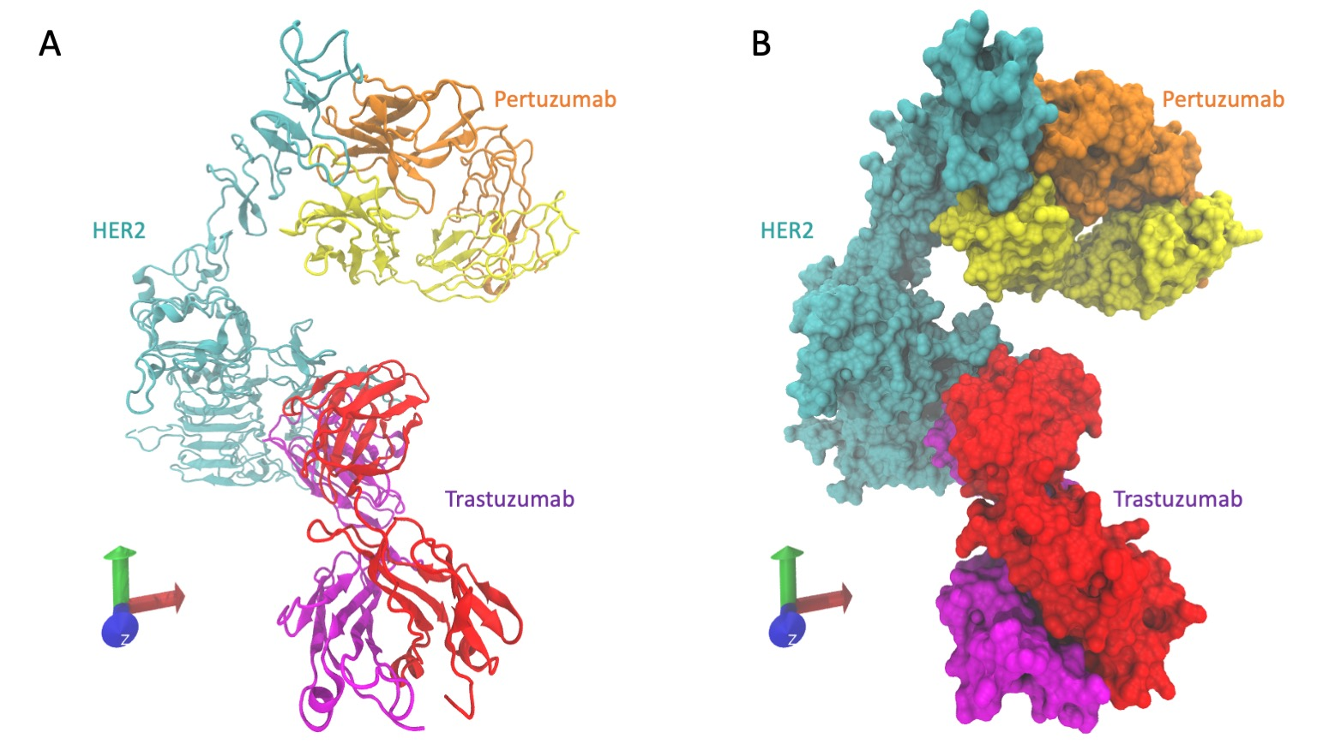
Treatment
VaudBiotech
Figure 1. Cryo-EM structure of HER2 (cyan) extracellular domain, Trastuzumab Fab (Herceptin - red and pink), and Pertuzumab Fab complex (Perjeta - yellow and orange). Derived from PDB 6OGE https://doi.org/10.1371/journal.pone.0216095.

Slide 8
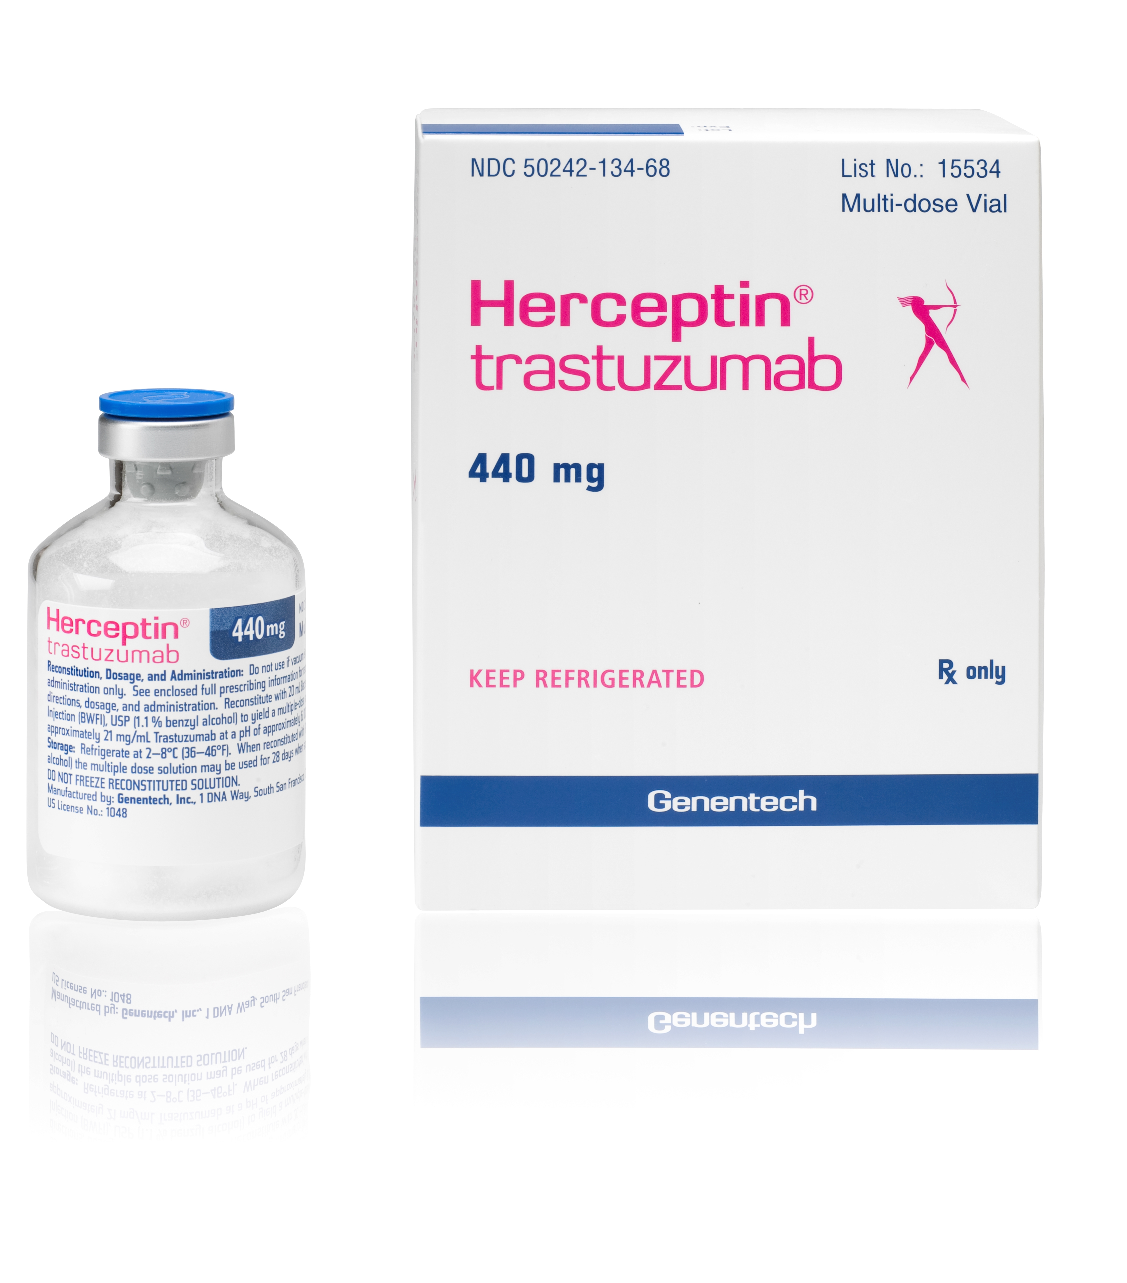
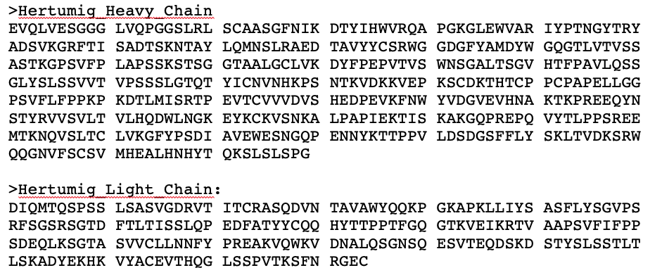

Treatment
Hertumig
hertuzumab
VaudBiotech
VaudBiotech

Slide 9
History
Monoclonal antibodies (mAb) as cancer therapy
1890 Neutralizing effect on diphtheria (Zahavi 2020)
1980 mAb therapy for lymphoma
1990 Antibody humanization
A powerful tool for precision medicine (Zahavi 2020)
VaudBiotech
D. Zahavi and L. Weiner, “Monoclonal antibodies in cancer therapy,” Antibodies, vol. 9, no. 3, p. 34, 2020.

Slide 10
History
Ten targets account for 42% of approvals (Mullard 2020)
PD1/PDL1 CD20
TNF CGRP/CGRPR
HER2 VEGF/VEGFR
IL-6/IL-6R IL-23 p19
EGFR CD19
VaudBiotech
A. Mullard, “FDA approves 100th monoclonal antibody product.,” Nature reviews. Drug discovery, 2021.

Slide 11
History
100 mAb approved treatments (Mullard 2021)
Anti-HER2 development.
How is our mAb better?
VaudBiotech
A. Mullard, “FDA approves 100th monoclonal antibody product.,” Nature reviews. Drug discovery, 2021.

Slide 12
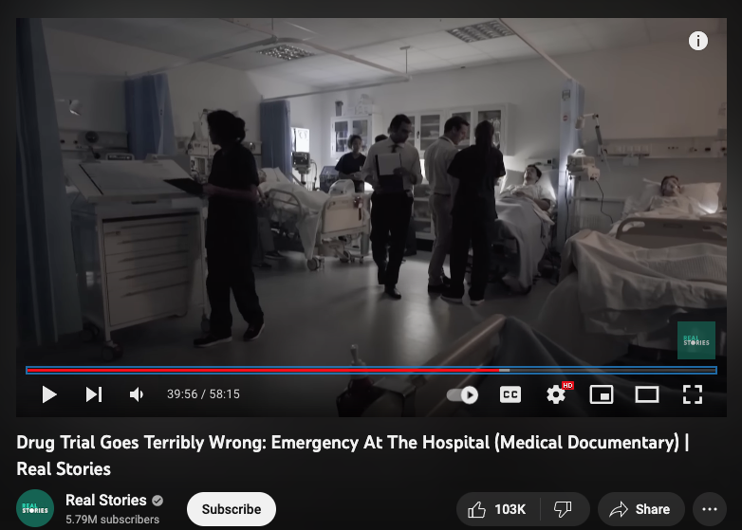
History
Risk (Suntharalingam 2006)
Phase 1 trial
Anti-CD28 mAb TGN1412
Systemic inflammatory response
All six volunteers
VaudBiotech
G. Suntharalingam et al., “Cytokine storm in a phase 1 trial of the anti-CD28 monoclonal antibody TGN1412.,” N Engl J Med, vol. 355, no. 10, pp. 1018–1028, Sep. 2006, doi: 10.1056/NEJMoa063842.

Slide 13
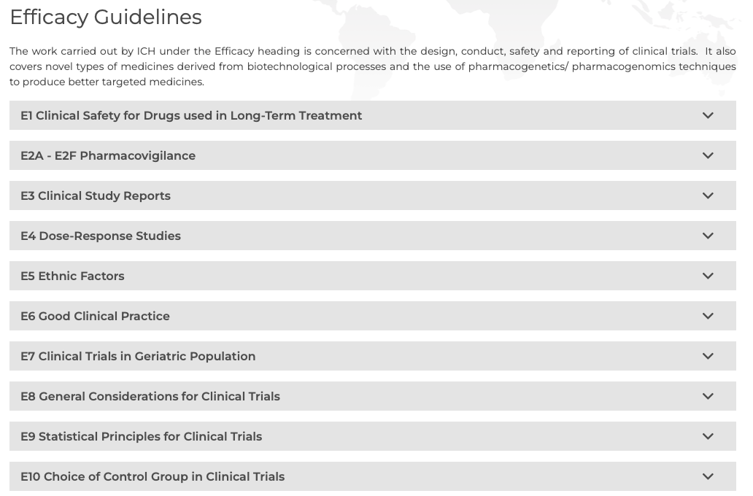
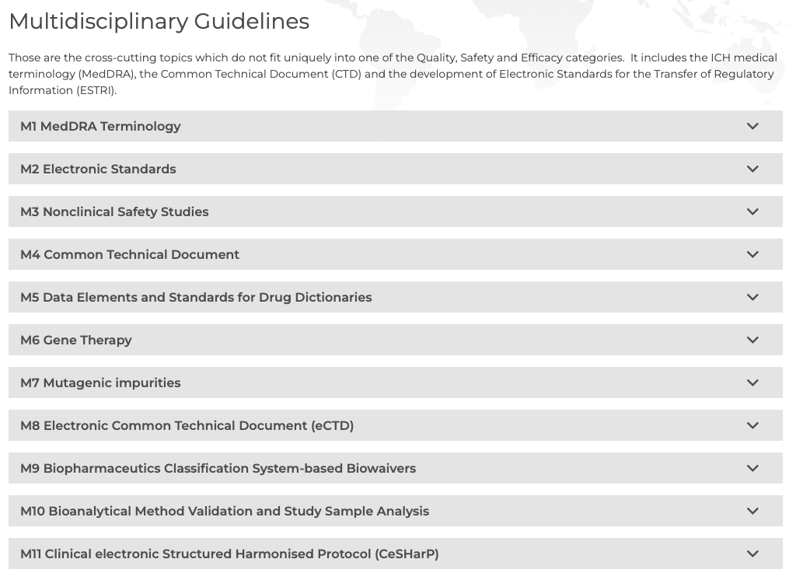
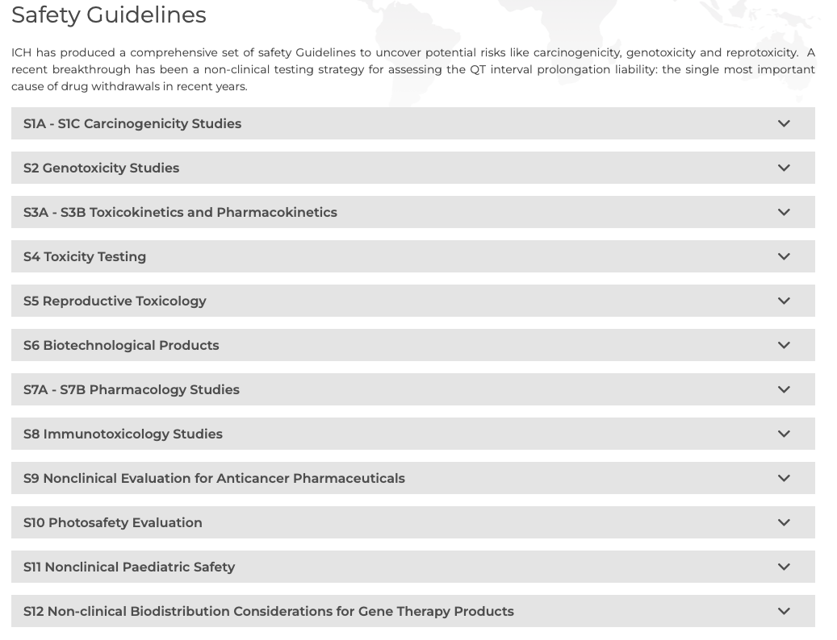
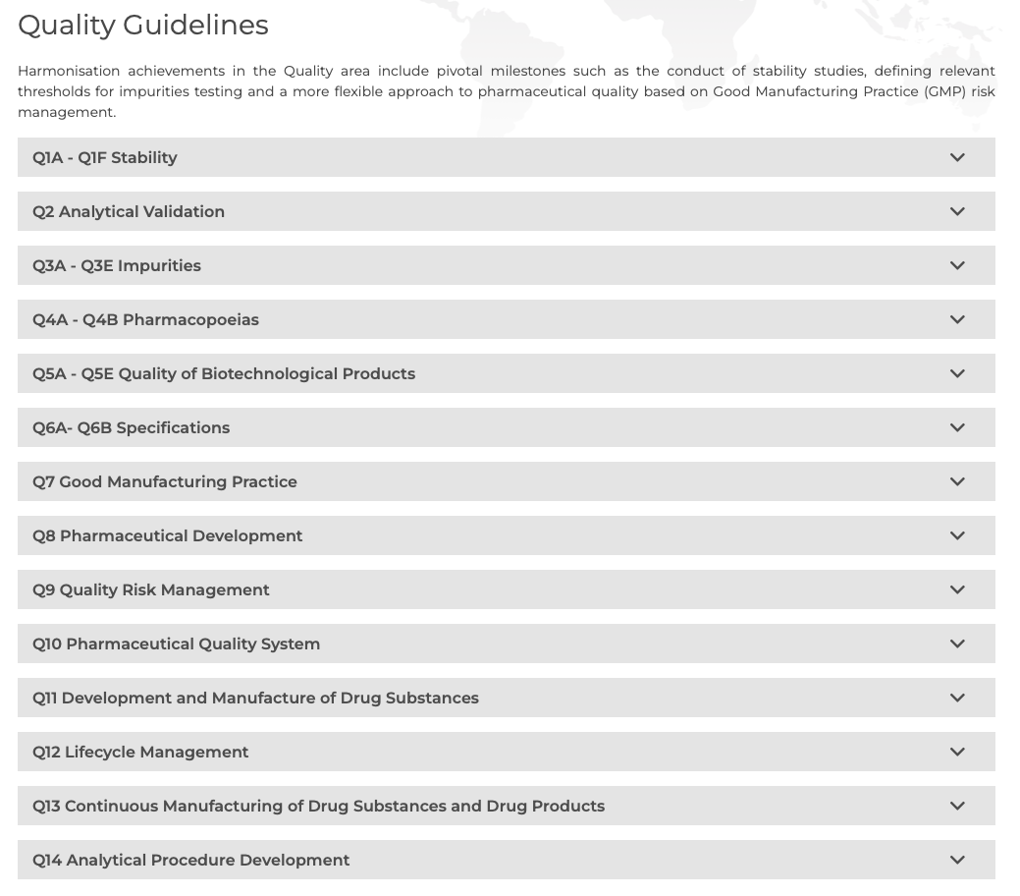
Guidelines and regulations
ICH
EMA
FDA
Quality
Safety
Efficacy
VaudBiotech

Slide 14
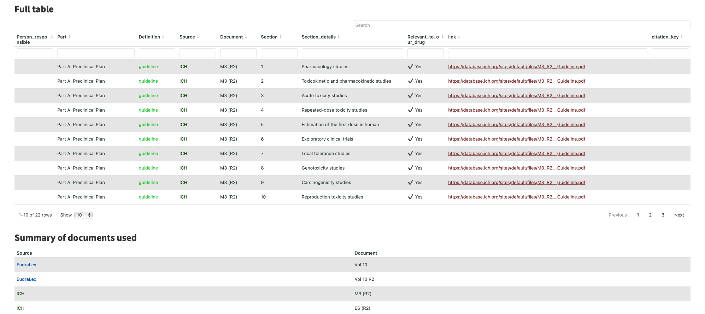
Guidelines and regulations
VaudBiotech

Slide 15
Pre-clinical
Internal only
Contribution and
documents cited.
Dylan: Trial design ICH M3 R2, EMA GLP , , ,
Dylan: Acute toxicity ICH M3 R2, EMA GLP
Dylan: Dosage ICH M3 R2, EMA GLP
Mouna: Pharmacodynamic
Mouna: Pharmacokinetic and toxicokinetic ICH M3 R2
Raluca: Toxico-pharmacological aspects
Raluca: Pharmacodynamics
Raluca: Toxicology Single Dose
Raluca: Exploratory Clinical Trials ICH M3 R2
Raluca: Local Tolerance Clinical Trials ICH M3 R2
Priya: Combinational Study ICH M3 R2, ICH S9
Priya: Genotoxicity ICH M3 R2, ICH S9, ICH S6 R1
VaudBiotech

Slide 16
Pre-clinical
Aim | Phase | Type | Dosage | Subject | Number of subjects | Duration | Study ID | Study guide
Tolerance | Preclinical | Acute single dose GLP | 0, 10, 50 and 100 mg/kg | Mice (M+F) | 5M, 5F | 2 weeks | HP0030 | H0030_preclinical_acute_toxicity_study_handbook.pdf
Tolerance | Preclinical | Acute single dose GLP | 0, 5, 25 and 50 mg/kg | Rhesus monkey (M+F) | 2M, 2F | 2 weeks | HP0031 | H0031_preclinical_acute_toxicity_study_handbook.pdf
Tolerance | Preclinical | Acute single dose GLP | 0, 5, 25 and 50 mg/kg | Rhesus monkey (M+F) | 2M, 2F | 2 weeks | HP0031a | H0031a_preclinical_acute_toxicity_liquidv2_study_handbook.pdf
Tolerance | Preclinical | Acute single dose GLP | 1.5 mg/kg | Rhesus monkey (M+F) | 2M, 2F | 2 weeks | HP0031b | H0031b_preclinical_acute_toxicity_manufac_study_handbook.pdf
Tolerance | Preclinical | Acute single dose GLP | 1.5 mg/kg | Rhesus monkey (M+F) | 2M, 2F | 2 weeks | HP0031c | H0031c_preclinical_acute_toxicity_lyoph_study_handbook.pdf
VaudBiotech

Slide 17
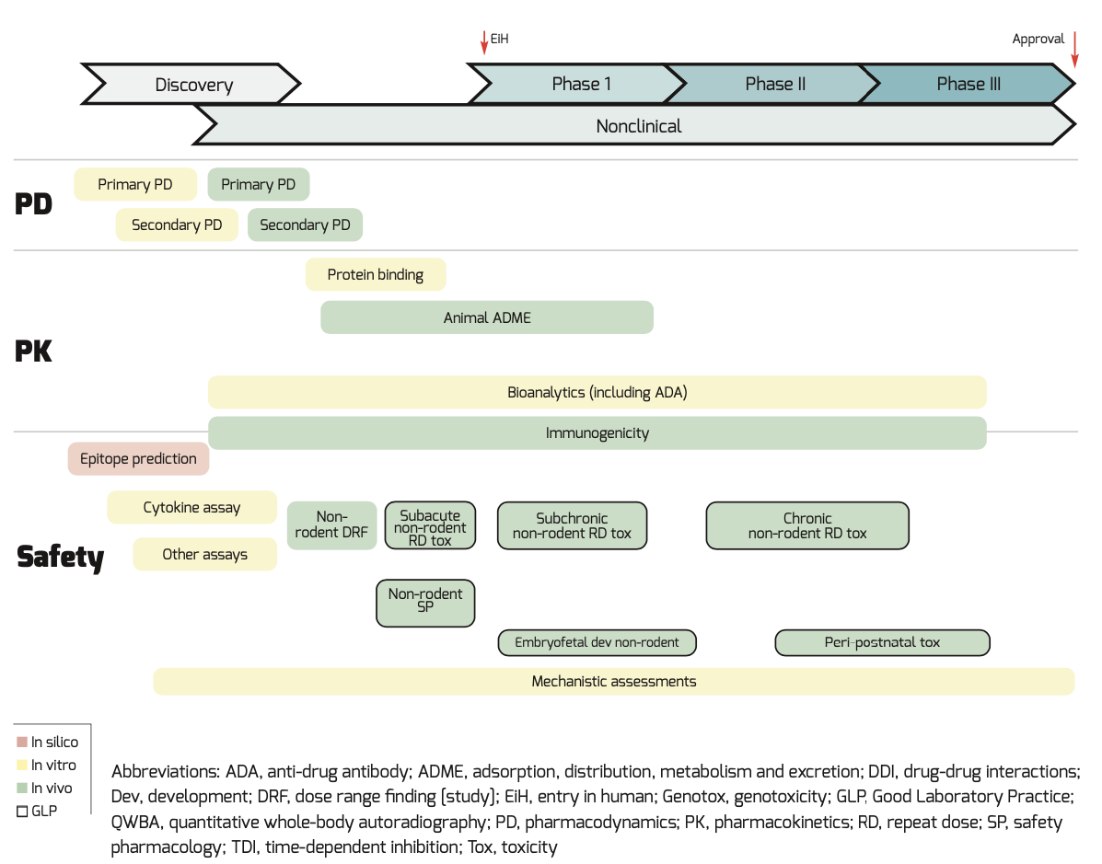
Pre-clinical
VaudBiotech
Nürnberg and Pierre 2017.

Slide 18
Clinical
Internal only
Contribution and
documents cited.
Dylan: Trial design ICH M3 , ICH E6 , Ledford 2013 ,
Woodcock and LaVange 2017 , PRIME (EU)
Dylan: Clinical trial dosage ICH E6 , dosage [26], safety and side effects [33],
risk FIH mAb [31], therapeutic mAb [26].
Mouna: PK/PD
Raluca: Clinical plan ICH E6
Priya: Clinical plan ICH E6 , ICH M3
VaudBiotech

Slide 19
Clinical
Aim | Phase | Type | Dosage | Subject | Number of subjects | Duration | Study ID | Study guide
Tolerance | 1 | Acute single dose GLP | 10, 50, 100, 250 mg single dose | Women without chemotherapy | 20 | 30 days | HC1030 | HC1030_clinical_acute_tox_study_handbook.pdf
Tolerance | 1 | Acute single dose GLP | 10, 50, 100, 250 mg single dose | Women with chemotherapy | 20 | 30 days | HC1031 | HC1031_clinical_acute_tox_with_chemo_study_handbook.pdf
Efficacy and toxicity of mAb alone | 2 | Multiple dose | 250 mg initial, 100 mg weekly | Women without chemotherapy >3 weeks | 40 | 9 weeks | HC2030 | HC2030_clinical_multi_study_handbook.pdf
Chometherapy + mAb | 2 | Multiple dose | 250 mg initial, 100 mg weekly | Women who have received chemotherapy | 40 | 9 weeks | HC2031 | HC2031_clinical_multi_with_chemo_study_handbook.pdf
Response after chemotherapy and relapse | 2 | Multiple dose | 4 mg/kg initial, 2 mg/kg weekly | Women with relapsed after chemotherapy | 250 | 9 weeks | HC2032 | HC2032_clinical_multi_with_chemo_study_handbook.pdf
Chemotherapy alone versus chemotherapy + mAb | 3 | Multiple dose | 4 mg/kg initial, 2 mg/kg weekly | Women without previous treatment | 500 | Until progression | HC3030 | HC3030_clinical_multi_versus_chemo_study_handbook.pdf
VaudBiotech

Slide 20
Manufacturing
Internal only
Contribution and
documents cited.
Dylan: Manufacturing Process and Process Controls EudraLex Vol 10 clinical trials guidelines,
EMA GMP
Dylan: Design spaces ICH Q8 , Jiang et al. Biotech and bioeng, 2010.
Dylan: Process Risk Assessment ICH Q9
Dylan: Specifications ICH Q6B
Dylan: Control strategy ICH Q10 , CMC BWG CASSS and ISPE, 2009.
Dylan: Regulatory Filing and Process Monitoring ICH M4 ,
Raluca: Chemistry, Manufacturing and Controls
Priya: Chemistry, Manufacturing, and Controls
Priya: Control of Drug substances and Drug products – Characterization
Priya: Purification EudraLex Vol 10 clinical trials guidelines , EudraLex Vol 3 production and quality control.. ,
ICH Q6B , EMA/CHMP/BWP/532517/2008.
VaudBiotech

Slide 21
Manufacturing
Chemistry, Manufacturing and Controls:
EudraLex Vol 10 clinical trials guidelines
Multiple ICH guidelines.
Good manufacturing practice (EMA GMP)
Process Risk Assessment:
FMECA based on ICH Q9, RPN, severity score.
Continuous production
VaudBiotech

Slide 22
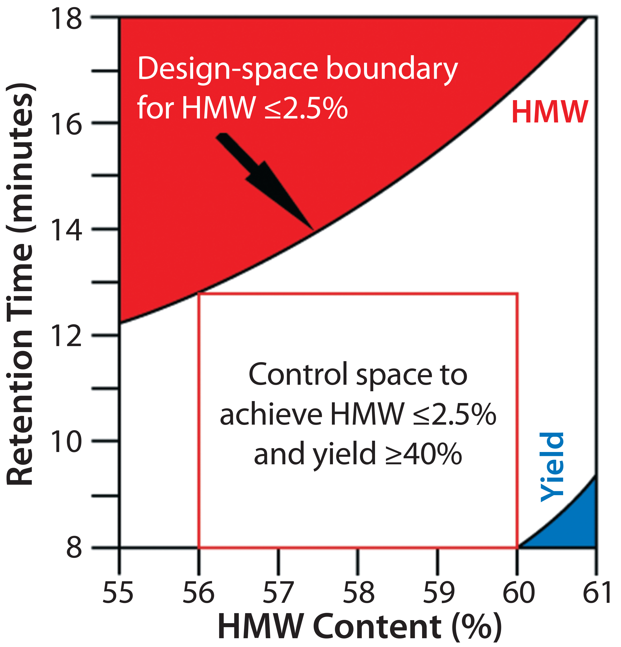
Manufacturing
Specifications of design spaces
ICH Q6B , tests, analytical references, and acceptance criteria.
Figure: Example of our design space for a hydrophobic-interaction chromatography (HIC) step used to purify an Fc fusion protein
Jiang et al. Biotech and bioeng, 2010.
VaudBiotech

Slide 23
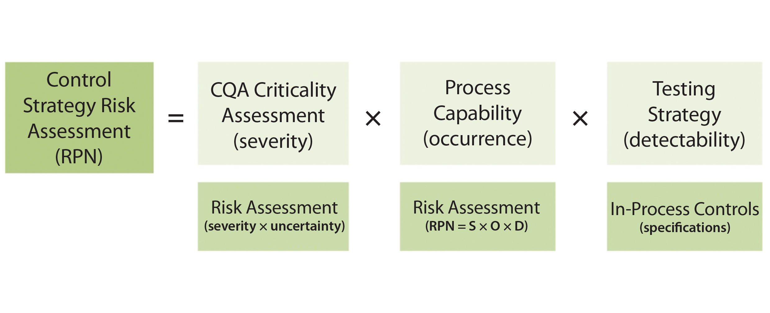
Manufacturing
Control strategy
ICH Q10
QbD and traditional
Regulatory Filing and Process Monitoring
ICH M4
CTD for NDA
Figure: Control strategy risk assessment combines criticality assessment of quality attributes with process capability and testing strategy to determine the risk priority number (RPN) for a control strategy. CMC BWG CASSS and ISPE, 2009.
VaudBiotech

Slide 24
Manufacturing
Quality attributes and methods used to evaluate Hertumig production
Protein content | Concentration [ultraviolet (UV) spectroscopy at 280 nm]
Primary structure | Peptide mass fingerprinting by liquid chromatography (LC) with electrospray (ESI) mass spectrometry (MS) detection
 | Intact molecular mass (LC-ESI-MS)
 | Reduced molecular mass (LC-ESI-MS)
Higher order structure | Near and far UV circular dichroism (CD)
 | Fourier transform infrared spectroscopy (FTIR)
 | Intrinsic fluorescence (IF)
 | LC-ESI-MS (disulfide bond characterization)
 | Differential scanning calorimetry (DSC)
 | Ellman’s reagent (free cysteines)
Size Variants, Aggregates | Size exclusion high performance liquid chromatography (SEC-HPLC) with UV detection
 | SEC with multi-angle light scattering (MALS)
 | Analytical ultracentrifugation sedimentation velocity (AUC)
 | Capillary Electrophoresis-Sodium Dodecyl Sulfate (CE-SDS, Reduced and Non-Reduced)
Charge and Hydrophobic variants | Capillary isoelectric focusing (cIEF)
 | Cation exchange HPLC (CEX-HPLC)
 | Hydrophobic interaction chromatography (HIC-HPLC)
 | LC-ESI-MS (oxidation)
Glycosylation | Normal phase (NP)-HPLC (glycan mapping)
 | Reverse phase (RP)-HPLC (afucosylation and sialic acid)
 | CE-SDS reduced (Non-glycosylated heavy chain)
 | Boronate affinity chromatography (glycation)
Potency | HER2 binding assay by flow cytometry
 | Inhibition of proliferation bioassay
 | Antibody-dependent cellular cytotoxicity (ADCC) bioassay (PBMC as effector cells)
Fc-receptor binding and function | FcγRIIIa V type binding affinity (Biacore)
 | FcγRIIIb binding affinity (Biacore)
 | FcγRIIa binding affinity (Biacore)
 | FcγRIIb binding affinity (Biacore)
 | FcγRIa binding affinity (Biacore)
 | FcRn binding affinity (Biacore)
 | Cellular dependent cytotoxicity (CDC) bioassay
 | C1q binding assay (ELISA)
VaudBiotech

Slide 25
Scientific advice
Internal only
Contribution and
documents cited.
Dylan: EMA Scientific Advice overview EMA CHMP , EMA SAWP, IRIS platform , EMA SOP , SOP/H/3037 .
Dylan: Parallel scientific advice FDA Pre-IND , EMA Scientific advice
Dylan: Application timetable EMA SAWP
Dylan: Dose response studies
Dylan: Non-clinical aspects ICH S9 , ICH S6
Priya: Pre-IND Meeting
Priya: Scientific Advice EMA CHMP
Priya: Parallel scientific advice FDA Pre-IND
VaudBiotech

Slide 26
Scientific advice
IRIS platform
Committee for Medicinal Products for Human Use (CHMP) on the recommendation of the Scientific Advice Working Party (SAWP)
Regulatory and procedural guidance on SA - EMA guidance for applicants
SOP EMA 01-DEC-15 SOP/H/3037 - regulatory and procedural guidance for scientific advice.
Hertumig EMA Scientific advice document
Overview of product development: Quality information, non-clinical information, known clinical pharmacology of similar drugs and those predicted.
Questions on quality development: Non-clinical and clinical development, significant benefit, and other CHMP comments.
PRIME Scheme
VaudBiotech

Slide 27
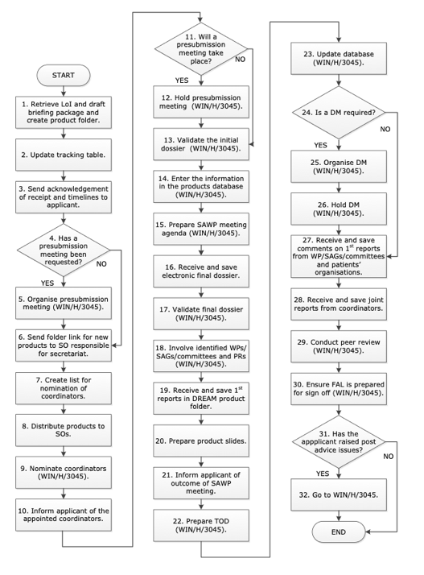
Scientific advice
Figure: Scientific Advice and Protocol Assistance procedure from EMA.
Standard operating procedure 01-DEC-15 SOP/H/3037 from EMA regulatory and procedural guidance for scientific advice.
VaudBiotech

Slide 28
Scientific advice
Date | Submission and validation phase
24 Oct 22 | Preparatory meeting | Application submission via IRIS
2 Nov 22 – 22 Dec 22 | Preparatory meeting | Preparatory meeting period
5 Dec 22 |  | Application submission via IRIS
4 Jan 23 |  | Final briefing document by
Date | Evaluation phase
9 – 12 Jan 2023 | SAWP1 | Start of procedure
6–9 Feb 2023 | SAWP2 | Reports discussed
20 – 23 Feb 2023 | D40 | CHMP Adoption
13 – 16 Mar 2023 | SAWP3 | Discussion Meeting (if required)
27 – 30 Mar 2023 | D70 | CHMP adoption
11 – 14 Apr 2023 | PRAC endorsement | (PASS procedures only)
VaudBiotech

Slide 29
Inspections
Internal only
Contribution and
documents cited.
Dylan Reasons and readiness key points. EudraLex Vol 10 clinical trials guidelines , EMA GCP
Priya: Inspection Readiness (IR) EudraLex Vol 10 clinical trials guidelines
VaudBiotech

Slide 30
Inspections
VaudBiotech

Slide 31
Overall strategy and advice
Internal only
Contribution and
documents cited.
Dylan: Strategy key points ICH, EMA CHMP , EMA SAWP,
Priya: Overall strategy EMA CHMP , EMA SAWP,
VaudBiotech

Slide 32
Overall strategy and advice
VaudBiotech

Slide 33
Take home message
VaudBiotech

Slide 34



Thanks
Gautam Maitra
Fiorella Ghisays
Dr. Seng Chin Mah
Natalia Giovannini
Prof. Bart Deplancke
VaudBiotech

Slide 35
Questions
Who wants their contact info shown here during questions?
Dylan
…
VaudBiotech

Slide 36
Reference only
ICH M3 Non-clinical safety studies for the conduct of human clinical trials for pharmaceuticals (R2).
ICH E6: Guideline for good clinical practice (R2),
ICH Q8 Pharmaceutical development.
ICH Q9 Quality risk management.
ICH Q6B Specifications: test procedures and acceptance criteria for biotechnological/biological products.
ICH Q10 Pharmaceutical quality system.
ICH M4 Common technical document (CTD) for the registration of pharmaceuticals for human use - organisation of CTD (R4).
ICH S6 Preclinical safety evaluation of biotechnology-derived pharmaceuticals.
ICH S9 Non-clinical evaluation for anticancer pharmaceuticals.
EudraLex Volume 10 clinical trials guidelines
Good manufacturing practice: (EMA GMP)
Good laboratory practice compliance (EMA GLP)
Good clinical practice (EMA GCP)
VaudBiotech

